Slide 1
Advancements in Tree Ensembles
Brendan Kolisnik, Taewoo Kim
2024-01-25

Slide 2
Agenda
Recap XGBoost and LightGBM
Highlight the main difference between xgboost and lightgbm and how they have converged with depthwise growth
Base score
Categorical Feature Splitting
Proof of Categorical Feature Splitting Time Complexity
Multi-target Trees Model Structure
Multi-target Trees Performance
XGBoost 2.0

Slide 3

XGBoost Introduction: Regularized Objective
Given dataset with n examples and m features.
A tree ensemble uses K additive functions to produce output.
Here q is the structure of our tree and maps the feature vector to a leaf index.
Notes:
Mention so our xgboost model prediction is the sum of the prediction the output leaf score from each of the trees.

Slide 4
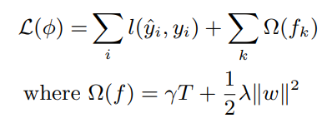
XGBoost Introduction: Regularized Objective
To learn the set of functions used in the model we minimize the following regularized objective:
Where l is a differentiable convex loss function and omega penalizes the complexity of the model. Here this is the L2 norm of the weights vector for a tree plus a scalar factor times the number of leaves.

Slide 5

XGBoost Introduction: Optimization
Since the tree ensemble has functions as parameters, we cannot use traditional optimization methods. Instead, we train the model in an additive manner. We want to optimize the following objective for ft(xi)
Where yhat is the prediction of the current ensemble on training example i. We initialize this as hyperparameter yhat0 = base_score. Base score default value is 0.5.
Notes:
Two key differences between this objective and the original gradient boosting paper from Friedman in 1999 is that this loss is a second order taylor polynomial whereas his was only a first order taylor polynomial, secondly this is regularized and thirdly is that we will take a fixed step size with each new tree based on a hyperparameter learning rate whereas Friedman performs a line search each iteration to determine the optimal step size for each new tree.

Slide 6

XGBoost: Base Score
We initialize f0(xi) = base_score. Base score default value is 0.5.
In recement versions of XGBoost this base_score can be inferred from target variable so that it is the scalar value that minimizes our convex loss function. This helps reduce number of trees.
Our ensemble prediction can also include a learning rate lambda which is applied to tree output. For now we will consider it to be 1.0
Notes:
Unlike the original boosted trees paper in 1999 thirdly we will take a fixed step size with each new tree based on a hyperparameter learning rate whereas Friedman performs a line search each iteration to determine the optimal step size for each new tree.

Slide 7
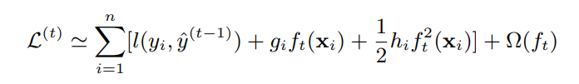
XGBoost Introduction: Optimization
Since the tree ensemble has functions as parameters, we cannot use traditional optimization methods. Instead, we train the model in an additive manner. We want to optimize the following objective for ft(xi)
We can approximate the loss of ft(xi) holding yi fixed as the second order Taylor polynomial
Where
Notes:
Two key differences between this objective and the original gradient boosting paper from Friedman in 1999 is that this loss is a second order taylor polynomial whereas his was only a first order taylor polynomial, secondly this is regularized and thirdly is that we will take a fixed step size with each new tree based on a hyperparameter learning rate whereas Friedman performs a line search each iteration to determine the optimal step size for each new tree.

Slide 8
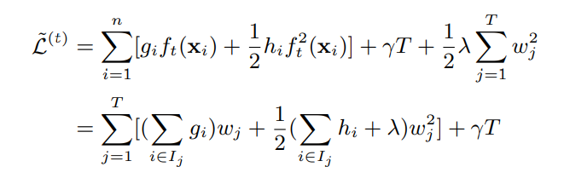
XGBoost: Fitting
Simply removing constants wrt ft(xi) we get the first line
Then rewrite the summation in terms of each of the leaves of our new tree and the instances within each leaf. Then the prediction within that leaf is wj.

Slide 9

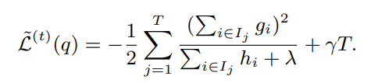
XGBoost: Fitting
Optimizing wrt to wj we get
Which achieves optimal loss
It is impossible to enumerate all possible tree structures q so we will add the split the improves the loss the most in greedy fashion one split at a time

Slide 10
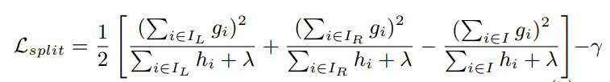
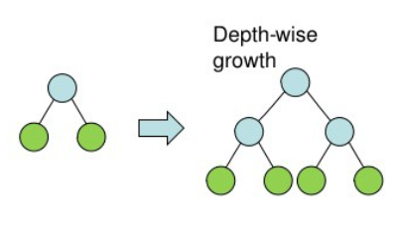
XGBoost: Depthwise treegrowth
Loss reduction after a split is given by
Depthwise tree growth means we simply iterate one level at a time creating splits.

Slide 11
XGBoost: Tree Methods
The construction algorithm used in XGBoost.

Slide 12
XGBoost: Sparsity Aware Splitfinding

Slide 13
LightGBM

Slide 14
Depthwise Growth

Slide 15
Categorical Feature Splitting

Slide 16
Proof of Categorical Feature Splitting Time Complexity

Slide 17
Multi-target Tree: Vector Leaf

Slide 18
Multi-target Tree: Hessian Approximation with vector

Slide 19
Multi-target Trees Performance

Slide 20
XGBoost 2.0 Recap
Distributed Training
Categorical Feature Split
Vector Leaf implementation

Slide 21
Appendix
Original Gradient Boosted Trees

Slide 22

Gradient Boosted Trees
Originally popularized by Friedman (1999).
Supervised learning problem to find function that minimize expected loss over training data.
Assume F has an additive form. Learn an ensemble of regression trees parameterized by split variables, split locations and terminal node means for each tree. The beta for a particular tree is a learnable multiplier.

Slide 23
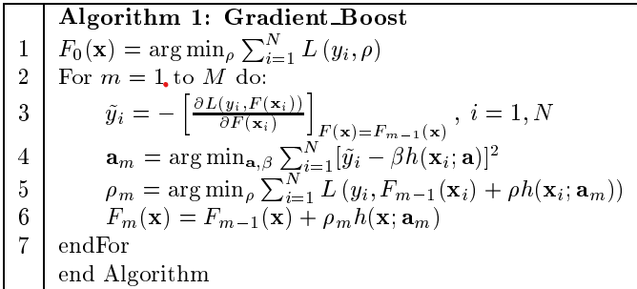
Gradient Boosted Trees

Slide 24

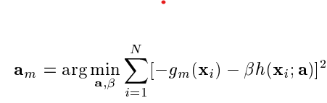
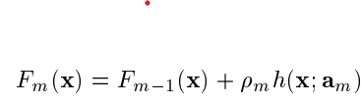
Gradient Boosted Trees
First get best steepest descent direction by obtaining the negative gradient of the loss for previous ensemble.
Then optimize the parameters for a new tree to minimize previous ensemble’s residuals. Notice this is independent of what loss function we chose.
Determine step size via line search and add current tree to ensemble.
Notes:
https://stats.stackexchange.com/questions/519203/does-wikipedia-explain-gradient-boosting-in-wrong-way
Not a fixed step size.

